Slide 1
Chapter 2: Intro to Relational Model

Slide 2
Outline
Structure of Relational Databases
Database Schema
Keys
Schema Diagrams
Relational Query Languages
The Relational Algebra
Notes:
1

Slide 3
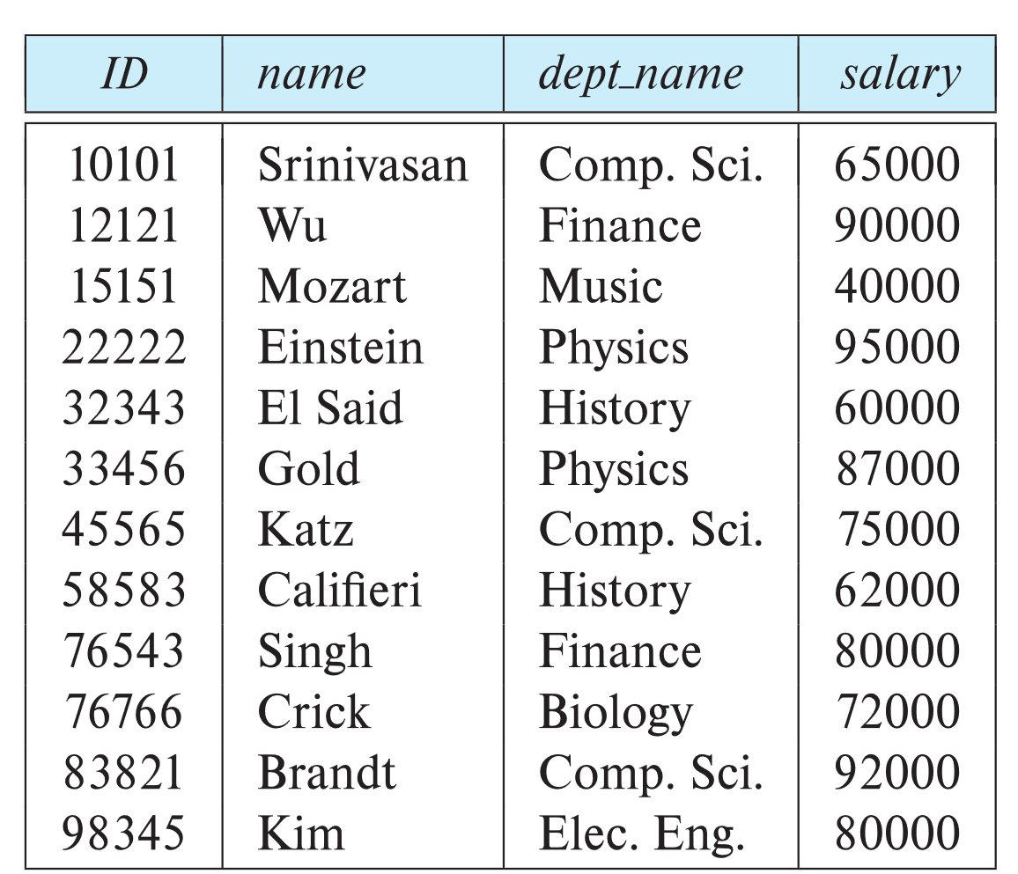
Example of a Instructor Relation
attributes
(or columns)
tuples
(or rows)

Slide 4
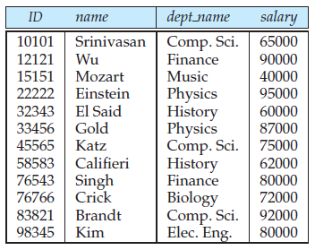
Relation Schema and Instance
A₁, A₂, …, A_{n} are attributes
R = (A₁, A₂, …, A_{n} ) is a relation schema
Example:
instructor = (ID, name, dept_name, salary)
A relation instance r defined over schema R is denoted by r (R).
The current values a relation are specified by a table
An element t of relation r is called a tuple and is represented by a row in a table
Relation=table
Tuple=row
Attribute=column
Notes:
1

Slide 5
Attributes
The set of allowed values for each attribute is called the domain of the attribute
Attribute values are (normally) required to be atomic; that is, indivisible
The special value null is a member of every domain. Indicated that the value is “unknown” or does not exist
The null value causes complications in the definition of many operations
For example: consider a relation student(rollno, name, phone) and for a particular tuple(row) student does not carry phone.
We shall see later that null values cause a number of difficulties when we access or update the database.
Relations are Unordered
Order of tuples is irrelevant (tuples may be stored in an arbitrary order)
Example: instructor relation with unordered tuples

Slide 6
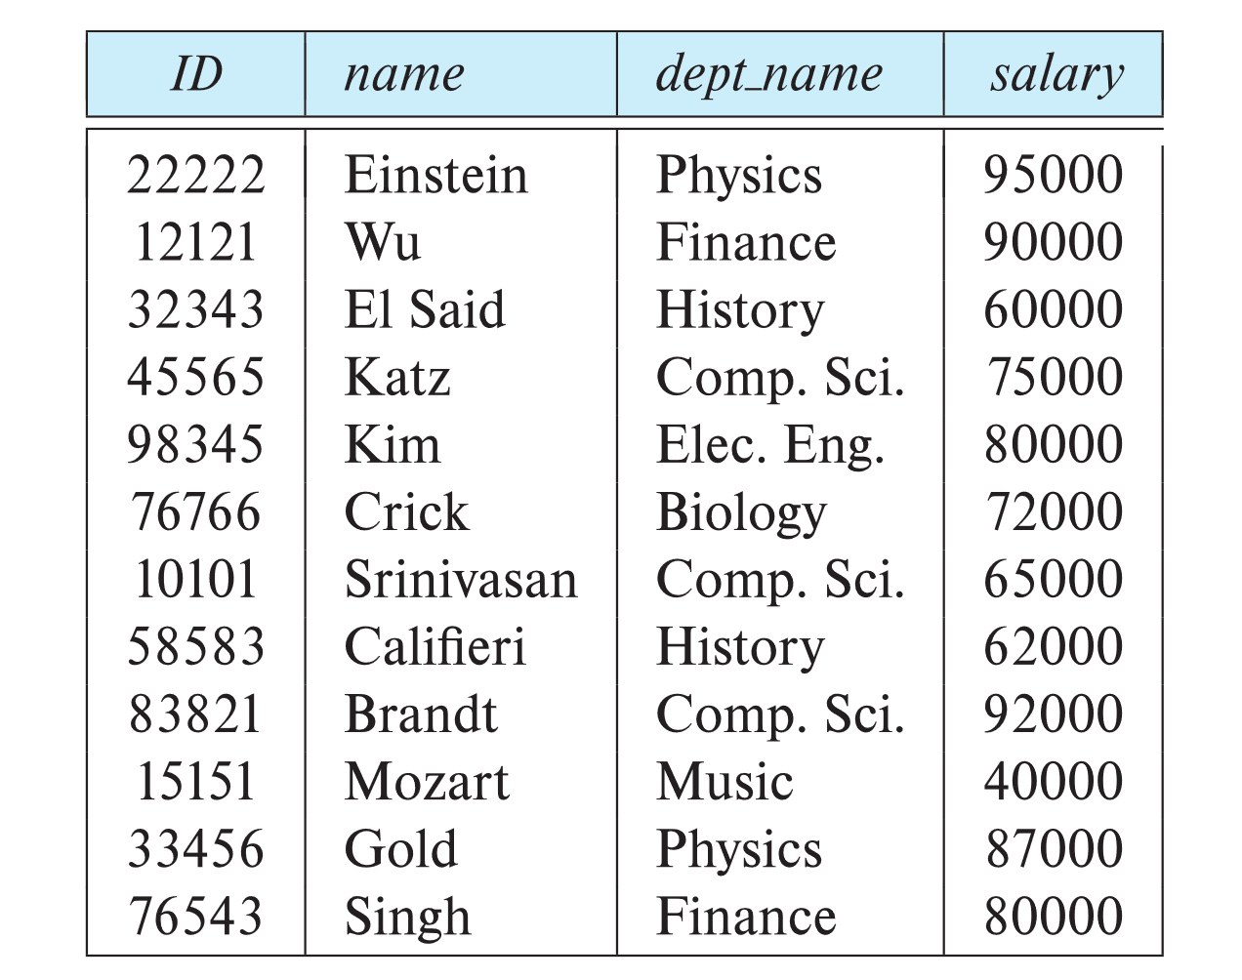
Database Schema
Database schema -- is the logical structure of the database.
Database instance -- is a snapshot of the data in the database at a given instant in time.
Example:
schema: instructor (ID, name, dept_name, salary)
Instance: Instance
Relational schema(related relations)
• student (ID, name, dept name, tot cred)
• advisor (s id, i id)
• takes (ID, course id, sec id, semester, year, grade)
• classroom (building, room number, capacity)
• time slot (time slot id, day, start time, end time)

Slide 7
Keys
We must have a way to specify how tuples within a given relation are distinguished i.e. attribute values of a tuple must be such that they can uniquely identify the tuple{no redandancy}
Let K ⊆ R
K is a superkey of R if values for K are sufficient to identify a unique tuple of each possible relation r(R) {set of one or more attributes that, taken collectively, allow us to identify uniquely a tuple in the relation}
Example: {ID} and {ID,name} are both superkeys of instructor.
Superkey K is a candidate key if K is minimal Example: {ID} is a candidate key for Instructor
One of the candidate keys is selected to be the primary key.
Which one?
Foreign key constraint: Value in one relation must appear in another
Referencing relation
Referenced relation
Example: dept_name in instructor is a foreign key from instructor referencing department

Slide 8
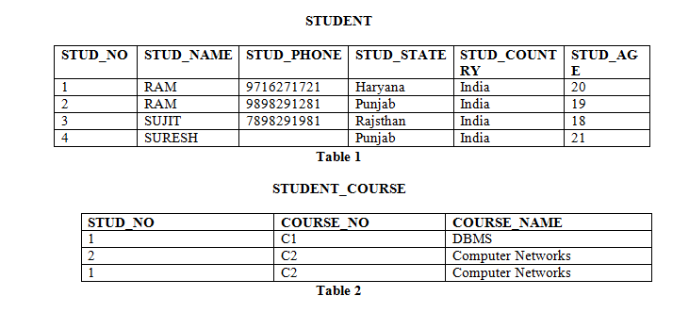
Candidate Key: The minimal set of attribute which can uniquely identify a tuple is known as candidate key. For Example, STUD_NO in STUDENT relation.
The value of Candidate Key is unique and non-null for every tuple.
There can be more than one candidate key in a relation. For Example, STUD_NO is candidate key for relation STUDENT.
The candidate key can be simple (having only one attribute) or composite as well. For Example, {STUD_NO, COURSE_NO} is a composite candidate key for relation STUDENT_COURSE.

Slide 9
Super Key: The set of attributes which can uniquely identify a tuple is known as Super Key. For Example, STUD_NO, (STUD_NO, STUD_NAME) etc.
Adding zero or more attributes to candidate key generates super key.
A candidate key is a super key but vice versa is not true.
Primary Key: There can be more than one candidate key in relation out of which one can be chosen as the primary key. For Example, STUD_NO, as well as STUD_PHONE both, are candidate keys for relation STUDENT but STUD_NO can be chosen as the primary key (only one out of many candidate keys).
Alternate Key: The candidate key other than the primary key is called an alternate key. For Example, STUD_NO, as well as STUD_PHONE both, are candidate keys for relation STUDENT but STUD_PHONE will be alternate key (only one out of many candidate keys).

Slide 10
Foreign Key: If an attribute can only take the values which are present as values of some other attribute,
it will be a foreign key to the attribute to which it refers.
The relation which is being referenced is called referenced relation and the corresponding attribute is called referenced attribute and the relation which refers to the referenced relation is called referencing relation and the corresponding attribute is called referencing attribute.
The referenced attribute of the referenced relation should be the primary key for it. For Example, STUD_NO in STUDENT_COURSE is a foreign key to STUD_NO in STUDENT relation.
It may be worth noting that unlike, Primary Key of any given relation, Foreign Key can be NULL as well as may contain duplicate tuples i.e. it need not follow uniqueness constraint.
For Example, STUD_NO in STUDENT_COURSE relation is not unique. It has been repeated for the first and third tuple. However, the STUD_NO in STUDENT relation is a primary key and it needs to be always unique and it cannot be null.

Slide 11
Example foreign key

Slide 12
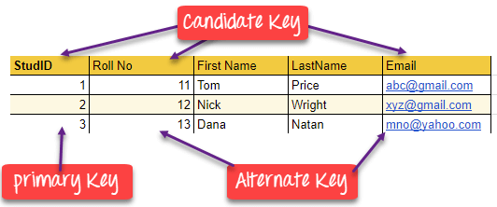

Slide 13
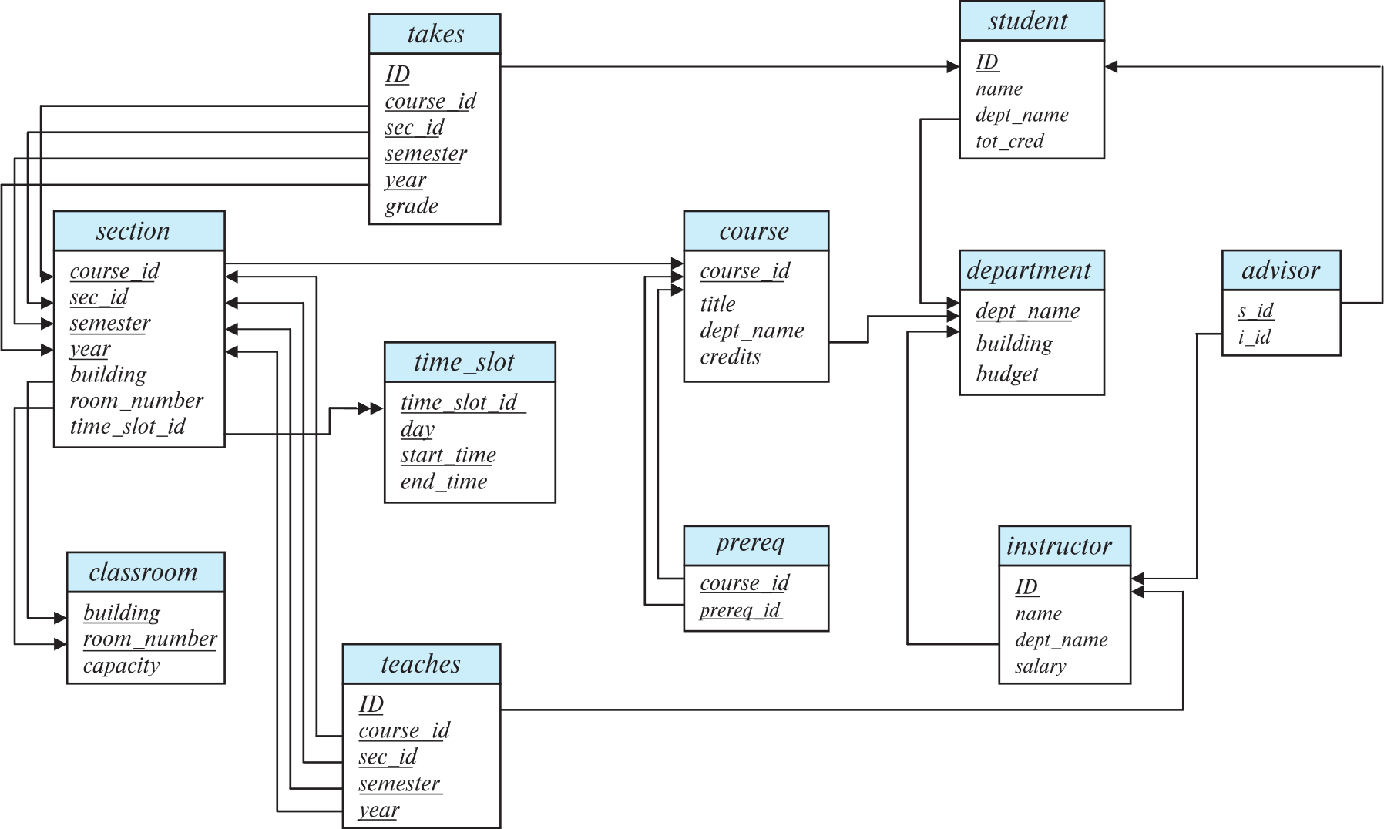
Schema Diagram for University Database

Slide 14
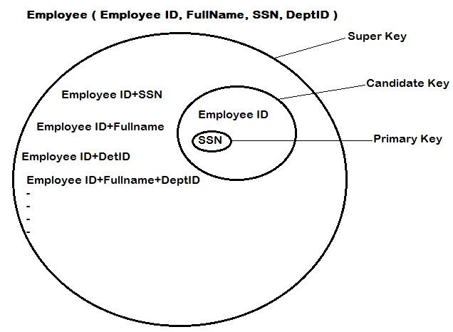
Candidate Key: are individual columns in a table that qualifies for uniqueness of all the rows. Here in Employee table EmployeeID & SSN are Candidate keys.
Primary Key: is the columns you choose to maintain uniqueness in a table. Here in Employee table you can choose either EmployeeID or SSN columns.
Super Key: If you add any other column/attribute to a Primary Key(candidate key) then it become a super key, like EmployeeID + FullName is a Super Key.
Alternate Key: Candidate column other the Primary column, like if SSN is PK then EmployeeID would be the Alternate key.

Slide 15
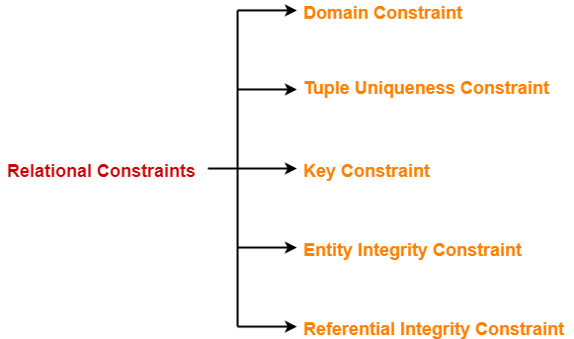
Constraints
Relational constraints are the restrictions imposed on the database contents and operations.
They ensure the correctness of data in the database.

Slide 16
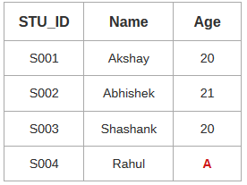
1. Domain Constraint-
Domain constraint defines the domain or set of values for an attribute.
It specifies that the value taken by the attribute must be the atomic value from its domain
Consider the following Student table-
Here, value ‘A’ is not allowed since only integer values can be taken by the age attribute.

Slide 17
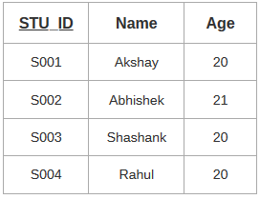
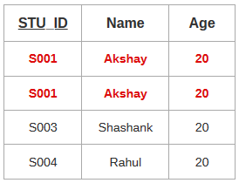
2. Tuple Uniqueness Constraint-
Tuple Uniqueness constraint specifies that all the tuples must be necessarily unique in any relation.
Consider the following table.
This relation satisfies the tuple uniqueness constraint since here all the tuples are unique.
The second relation does not satisfy the tuple uniqueness constraint since here all the tuples are not unique.

Slide 18
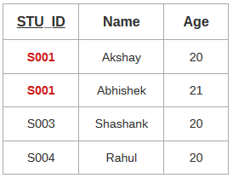
3. Key Constraint- Key constraint specifies that in any relation-
All the values of key must be unique.
Consider the table
This relation does not satisfy the key constraint as here all the values of primary key are not unique.

Slide 19
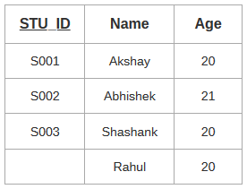
4. Entity Integrity Constraint-
Entity integrity constraint specifies that no attribute of primary key must contain a null value in any relation.
This is because the presence of null value in the primary key violates the uniqueness property.
Consider the table
This relation does not satisfy the entity integrity constraint as here the primary key contains a NULL value.

Slide 20
5. Referential Integrity Constraint-
This constraint is enforced when a foreign key references the primary key of a relation.
It specifies that all the values taken by the foreign key must either be available in the relation of the primary key or be null.
The following two important results emerges out due to referential integrity constraint-
We can not insert a record into a referencing relation if the corresponding record does not exist in the referenced relation.
We can not delete or update a record of the referenced relation if the corresponding record exists in the referencing relation.

Slide 21
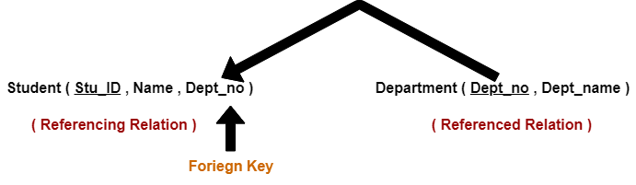
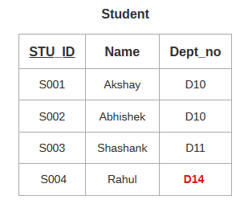
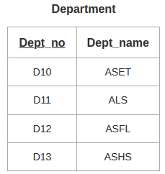
Here,
The relation ‘Student’ does not satisfy the referential integrity constraint.
This is because in relation ‘Department’, no value of primary key specifies department no. 14.
Thus, referential integrity constraint is violated.

Slide 22
RIC violation
RIC violation can occur on deletion or modification of a referenced tuple. On insertion there would be no violation. The Action to this can be specified for every case by using the qualifiers ON DELETE and ON UPDATE.
Actions to be taken are explained as follows :
After any violation to Referential Integrity Constraint has occurred, there can be three possibilities which can be used as an action : SET NULL, SET DEFAULT, CASCADE.
Referenced Relation : Table consists of Primary Key which is referenced by some foreign key. Actions :
DELETION :
ON DELETE NO ACTION : If referential integrity violation has occurred, the deletion would not be allowed.
ON DELETE CASCADE : In the case of referential integrity violation, the tuple would be deleted from both the relation i.e. Referenced as well as Referencing Relation. Whenever Primary Key is deleted, the corresponding tuple in the referencing relation is also deleted.
ON DELETE SET NULL : In the case of violation, then the values of FOREIGN KEY are set to NULL. If the FOREIGN KEY is a NOT NULL attribute , then ON DELETE SET NULL = ON DELETE NO ACTION.

Slide 23
UPDATION :
ON UPDATE NO ACTION : Updation would be restricted
ON UPDATE CASCADE : Updation would be performed in both the referenced as well as referencing relation.
ON UPDATE SET NULL : Referencing attribute tried to set NULL, if its a success , updation of referenced relation is allowed.
Referencing Relation :
INSERTION : Violation might occur. If the violation occurs, then insertion gets restricted.
DELETION : No violation occurs.
UPDATION : Referencing attribute may cause violation, in that case updation is not allowed.

Slide 24
SQL constraints
Not null
Create table emp(eid number(2) not null, ename varchar(10))
Unique
Create table emp(eid number(2) unique, ename varchar(10))
Primary key{unique-null}
Create table emp(eid number(2) primary key, ename varchar(10))
Foreign key
Create table person(pid int primary key, name varchar(10))
Create table order(oid int primary key, orderno int, pid int references person(pid))
Check
Create table person(pid int check(pid>0), name varchar(10))
Default
Create table emp(eid number(2), ename varchar(10),comm int default 0)

Slide 25
Relational Query Languages
Procedural versus non-procedural, or declarative
“Pure” languages:
Relational algebra
Tuple relational calculus
Domain relational calculus
The above 3 pure languages are equivalent in computing power
We will concentrate in this chapter on relational algebra
Not Turing-machine equivalent
Consists of 6 basic operations

Slide 26
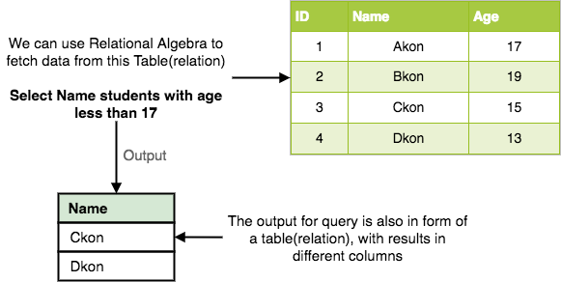
Relational Algebra
Every database management system must define a query language to allow users to access the data stored in the database.
Relational Algebra is a procedural query language used to query the database tables to access data in different ways.
In relational algebra, input is a relation(table from which data has to be accessed) and output is also a relation(a temporary table holding the data asked for by the user).

Slide 27
Relational Algebra
Relational Algebra works on the whole table at once, so we do not have to use loops etc to iterate over all the rows(tuples) of data one by one.
Relational Algebra is formal description of how relational database operates.
It is a procedural query language, i.e. user must define both “how” and “what” to retrieve.
All we have to do is specify the relation(table) name from which we need the data, and in a single line of command, relational algebra will traverse the entire given table to fetch data for you.

Slide 28


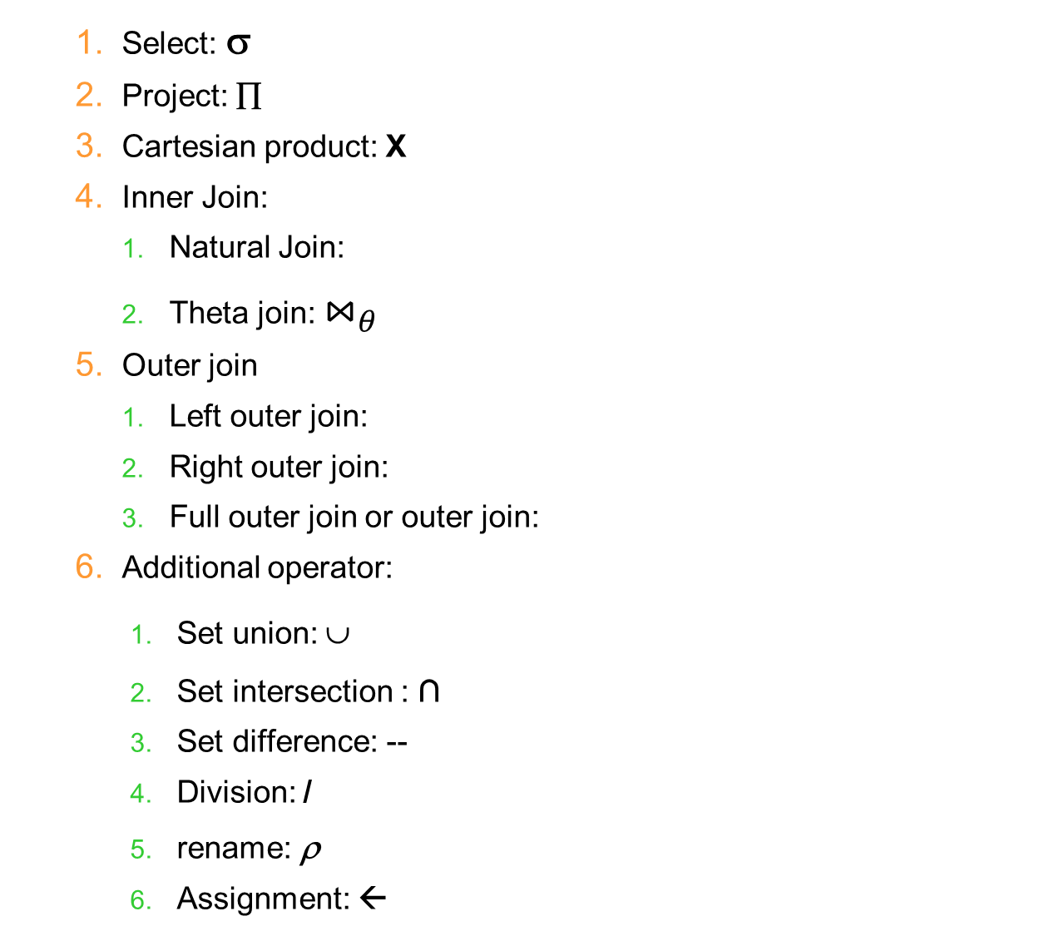
Operators
Select: σ
Project: ∏
Cartesian product: X
Inner Join:
Natural Join:
Theta join: $⋈_{θ}$
Outer join
Left outer join:
Right outer join:
Full outer join or outer join:
Additional operator:
Set union: ∪
Set intersection : ∩
Set difference: --
Division: /
rename: ρ
Assignment: ←

Slide 29
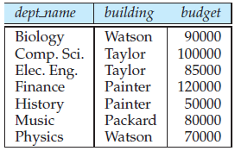
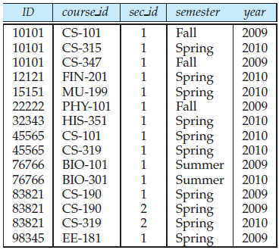
Relation
department
teaches
Instructor

Slide 30
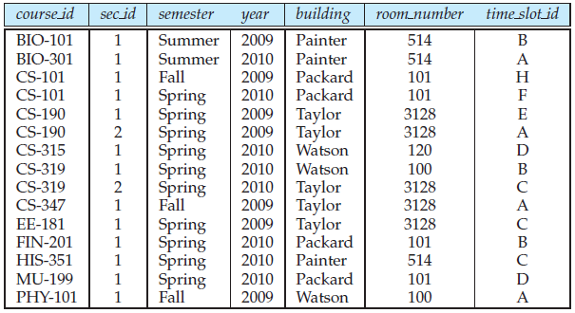
Section

Slide 31
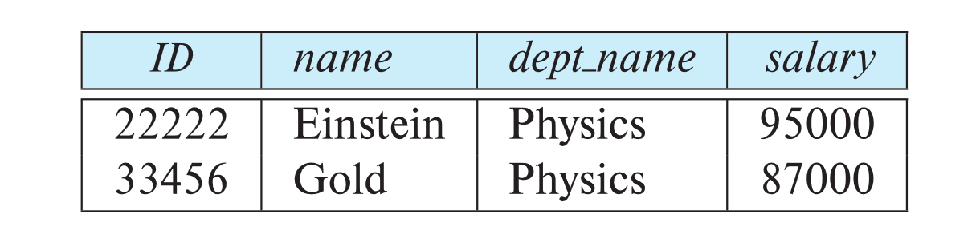
1. Select Operation
The select operation selects tuples that satisfy a given predicate.
Notation: σ _{p} (r)
p is called the selection predicate
Example: select those tuples of the instructor relation where the instructor is in the “Physics” department.
Query
σ _{dept_name=“Physics”} (instructor)
Result

Slide 32
Select Operation (Cont.)
We allow comparisons using
=, ≠, >, ≥. <. ≤
in the selection predicate.
We can combine several predicates into a larger predicate by using the connectives:
∧ (and), ∨ (or), ¬ (not)
Example: Find the instructors in Physics with a salary greater $90,000, we write:
σ _{dept_name=“Physics”} ∧ _{salary >} _{90,000} (instructor)
The select predicate may include comparisons between two attributes.
Example, find all departments whose name is the same as their building name:
σ _{dept_name=building} (department)

Slide 33
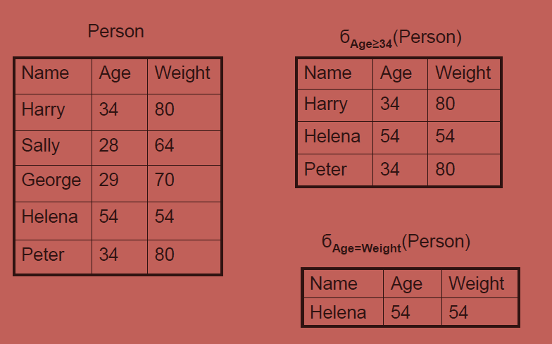
Examples

Slide 34
2. Project Operation
A unary operation that returns its argument relation, with certain attributes left out.(retrieves the columns)
Notation:
∏ _{A1,A2,A3 ….Ak} (r)
where A₁, A₂, …, A_{k} are attribute names and r is a relation name.
The result is defined as the relation of k columns obtained by erasing the columns that are not listed
Duplicate rows removed from result, since relations are sets

Slide 35
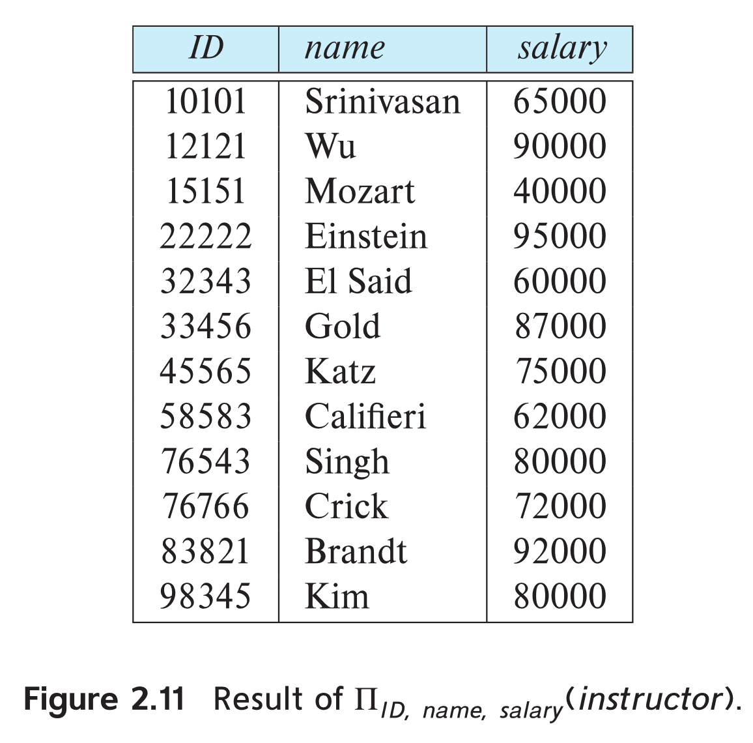
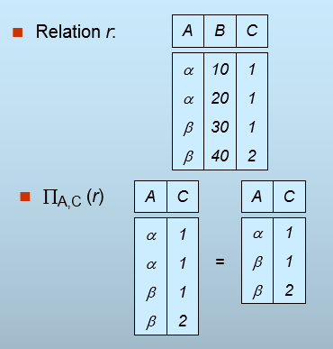
Project Operation Example
Example: eliminate the dept_name attribute of instructor
Query: ∏_{ID, name, salary} (instructor)

Slide 36
Composition of project & select Operations
The result of a relational-algebra operation is relation and therefore of relational-algebra operations can be composed together into a relational-algebra expression.
Consider the query -- Find the names of all instructors in the Physics department.
∏_{name}(σ _{dept_name} _{=“Physics”} (instructor))
Instead of giving the name of a relation as the argument of the projection operation, we give an expression that evaluates to a relation.

Slide 37
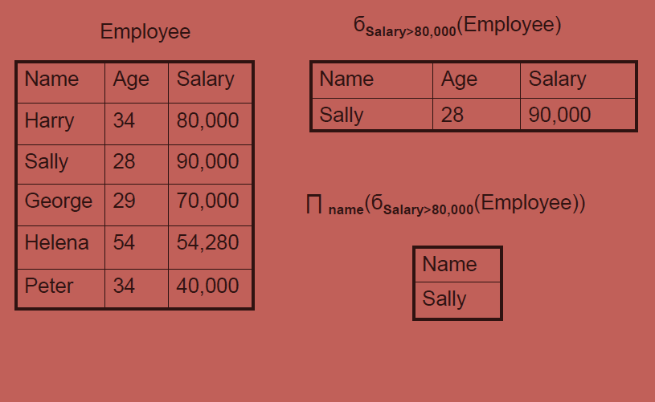
Examples

Slide 38
Merging relations
Fetching information's from two or more relations.
Cartesian product
Join
Natural join
Theta join
Outer join
Left outer join
Right outer join
Full outer join

Slide 39
3. Cartesian-Product Operation
The Cartesian-product operation (denoted by X) allows us to combine information from any two relations.
Example: the Cartesian product of the relations instructor and teaches is written as:
instructor X teaches
We construct a tuple of the result out of each possible pair of tuples: one from the instructor relation and one from the teaches relation (see next slide)
Since the instructor ID appears in both relations we distinguish between these attribute by attaching to the attribute the name of the relation from which the attribute originally came.
instructor.ID
teaches.ID

Slide 40
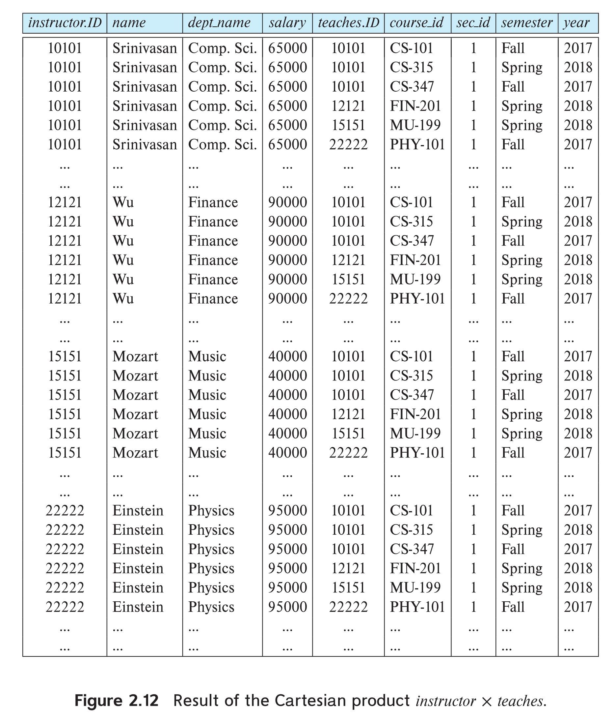
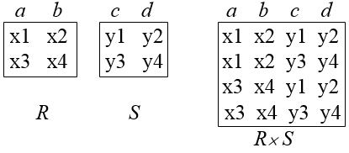
The instructor X teaches table

Slide 41
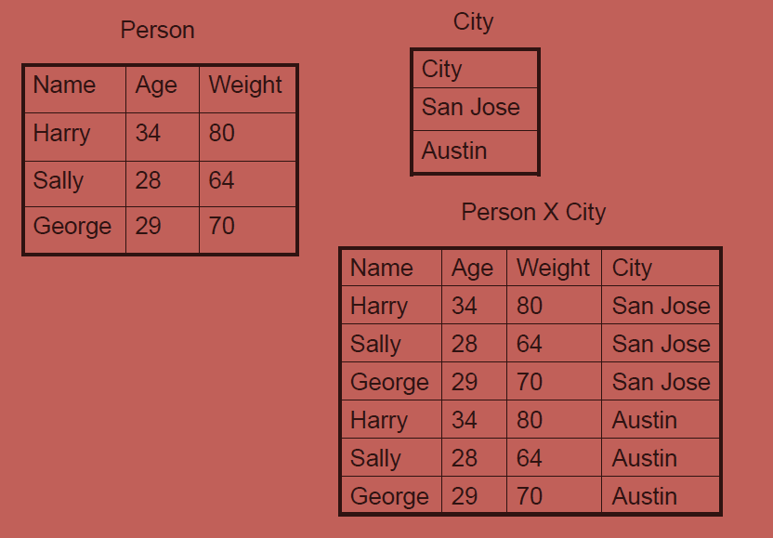
Examples

Slide 42
The Cartesian-Product
instructor X teaches
associates every tuple of instructor with every tuple of teaches.
Most of the resulting rows have information about instructors who did NOT teach a particular course.
To get only those tuples of “instructor X teaches “ that pertain to instructors and the courses that they taught, we write:
σ _{instructor.id = teaches.id} (instructor x teaches ))
We get only those tuples of “instructor X teaches” that pertain to instructors and the courses that they taught.
The result of this expression, shown in the next slide

Slide 43
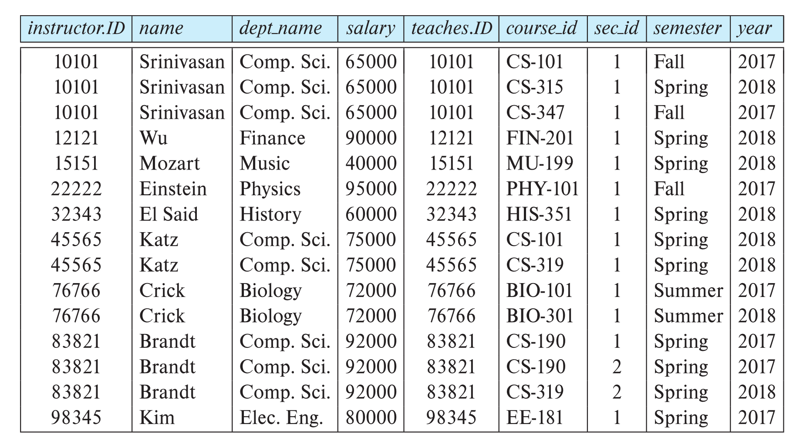
The table corresponding to:
σ _{instructor.id = teaches.id} (instructor x teaches))

Slide 44
4. Natural Join Operation
Natural join is a dyadic operator that is written as R S where R and S are relations. The result of the natural join is the set of all combinations of tuples in R and S that are equal on their common attribute names.
Let r and s be relations on schemas R and S respectively. Then, r s is a relation on schema R ∪ S obtained as follows:
Consider each pair of tuples t_{r} from r and t_{s} from s.
If t_{r} and t_{s} have the same value on each of the attributes in R ∩ S, add a tuple t to the result, where
t has the same value as t_{r} on r
t has the same value as t_{s} on s
Example:
R = (A, B, C, D)
S = (E, B, D)
Result schema = (A, B, C, D, E)
r s is defined as: ∏_{r.A, r.B, r.C, r.D, s.E} (σ_{r.B = s.B} ∧ _{r.D = s.D} (r x s))

Slide 45
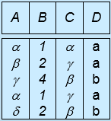
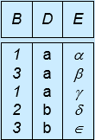
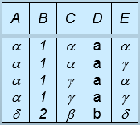
Natural Join Operation – Example
Relations r, s:
A
B
C
D
B
D
E





1
2
4
1
2





a
a
b
a
b
1
3
1
2
3
a
a
a
b
b





r
s
r s
A
B
C
D
E





1
1
1
1
2





a
a
a
a
b






Slide 46
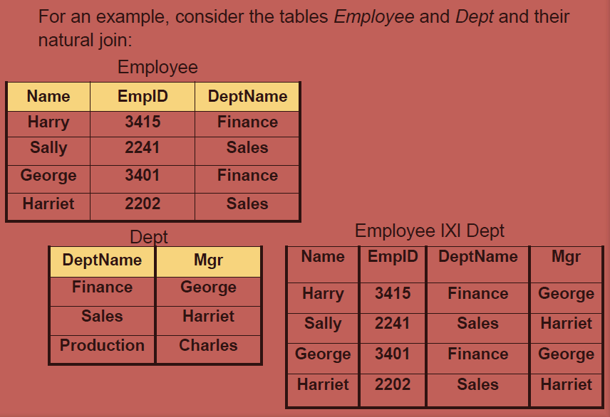
Examples

Slide 47
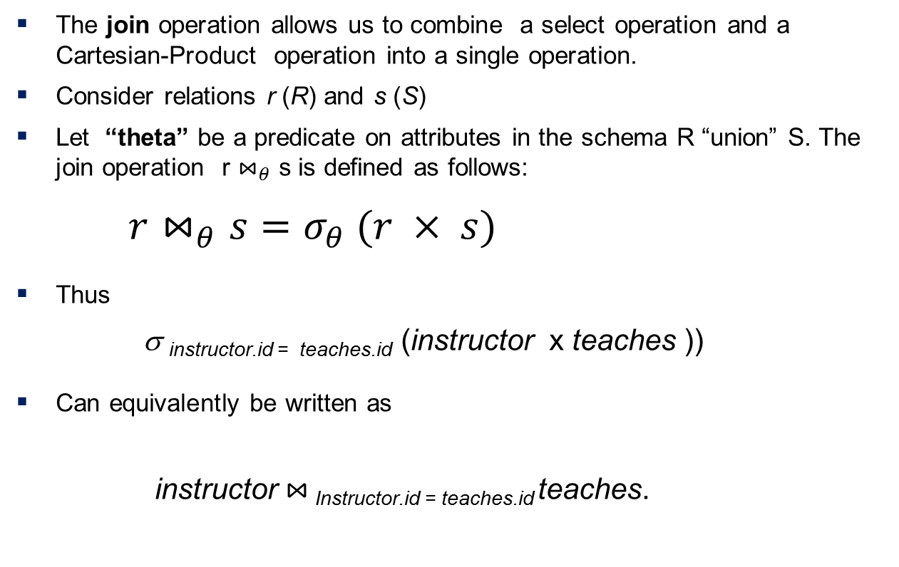
4.1 Theta Join Operation (Cont.)
The join operation allows us to combine a select operation and a Cartesian-Product operation into a single operation.
Consider relations r (R) and s (S)
Let “theta” be a predicate on attributes in the schema R “union” S. The join operation r $⋈_{θ}$ s is defined as follows:
$r⋈_{θ}s=σ_{θ} (r × s)$
Thus
σ _{instructor.id = teaches.id} (instructor x teaches ))
Can equivalently be written as
instructor $⋈_{ }$_{Instructor.id = teaches.id} teaches.

Slide 48
5. Outer join Operator
Left outer join: The left outer join is written as R =X S where R and S are relations. The result of the left outer join is the set of all combinations of tuples in R and S that are equal on their common attribute names, in addition to tuples in R that have no matching tuples in S.
Right outer join: The right outer join is written as R X S where R and S are relations. The result of the right outer join is the set of all combinations of tuples in R and S that are equal on their common attribute names, in addition to tuples in S that have no matching tuples in R.
Full outer join: The outer join or full outer join in effect combines the results of the left and right outer joins.

Slide 49
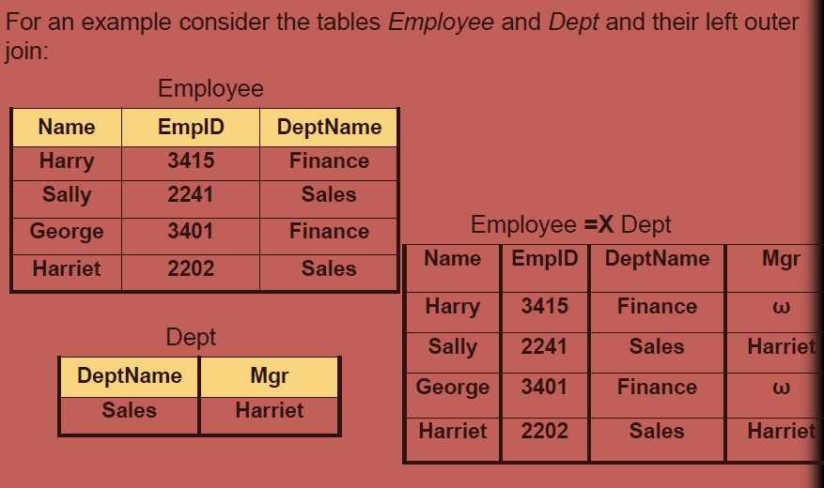
5.1 left outer join

Slide 50
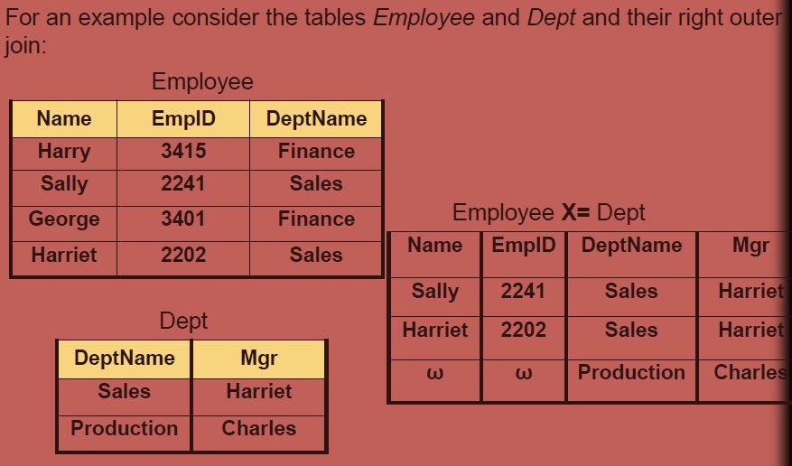
5.2 right outer join

Slide 51
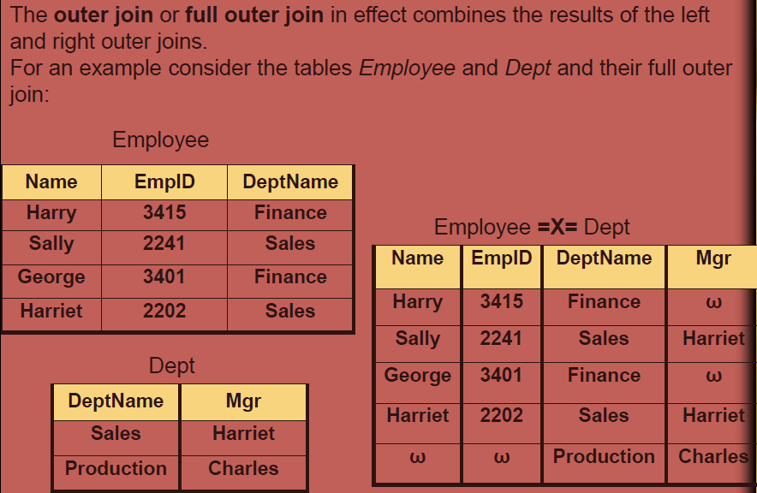
5.3 Full Outer join

Slide 52
6. Additional Operator
We define additional operations that do not add any power to the
relational algebra, but that simplify common queries.
Set union
Set intersection
Set difference
Division
Assignment

Slide 53
6.1 Union Operation
The union operation allows us to combine two relations
Notation: r ∪ s
For r ∪ s to be valid.
1. r, s must have the same arity (same number of attributes)
2. The attribute domains must be compatible (example: 2nd
column of r deals with the same type of values as does the
2nd column of s)
Example: to find all courses taught in the Fall 2017 semester, or in the Spring 2018 semester, or in both ∏_{course_id} (σ _{semester=“Fall” Λ year=2017} (section)) ∪ ∏_{course_id} (σ _{semester=“Spring” Λ year=2018} (section))

Slide 54
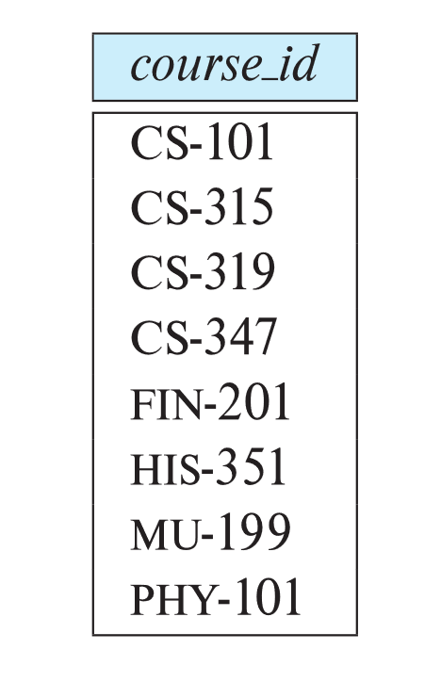
Union Operation (Cont.)
Result of: ∏_{course_id} (σ _{semester=“Fall” Λ year=2017} (section)) ∪ ∏_{course_id} (σ _{semester=“Spring” Λ year=2018} (section))

Slide 55
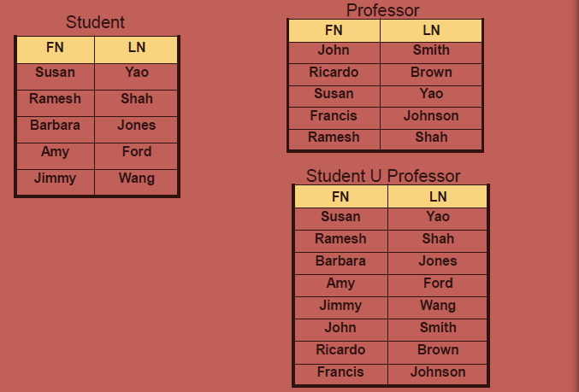
Example

Slide 56
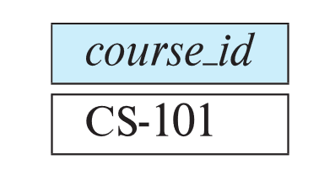
6.2 Set-Intersection Operation
The set-intersection operation allows us to find tuples that are in both the input relations.
Notation: r ∩ s
Exressed as :R ∩ S = R – (R – S)
Assume:
r, s have the same arity
attributes of r and s are compatible
Example: Find the set of all courses taught in both the Fall 2017 and the Spring 2018 semesters.
∏_{course_id} (σ _{semester=“Fall” Λ year=2017} (section)) ∩ ∏_{course_id} (σ _{semester=“Spring” Λ year=2018} (section))
Result

Slide 57
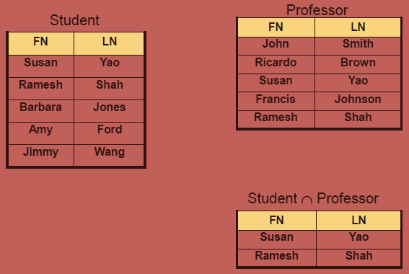
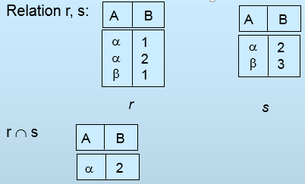
Example

Slide 58

6.3 Set Difference Operation
The set-difference operation allows us to find tuples that are in one relation but are not in another.
Notation r – s
Set differences must be taken between compatible relations.
r and s must have the same arity
attribute domains of r and s must be compatible
Example: to find all courses taught in the Fall 2017 semester, but not in the Spring 2018 semester ∏_{course_id} (σ _{semester=“Fall” Λ year=2017} (section)) − ∏_{course_id} (σ _{semester=“Spring” Λ year=2018} (section))

Slide 59
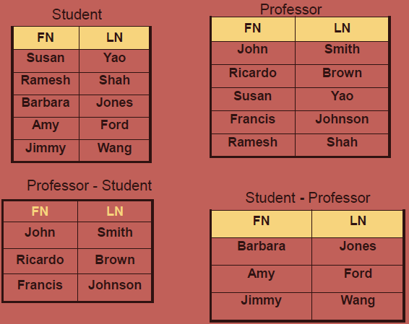
Example

Slide 60
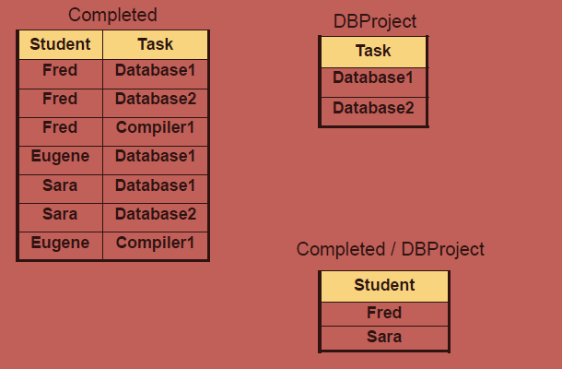
6.4 Division operator
The division operator takes as input two relations, called the dividend relation (r on scheme R) and the divisor relation (s on scheme S) such that all the attributes in S also appear in R and S is not empty.
The output of the division operation is a relation on scheme R with all the attributes common with S.

Slide 61
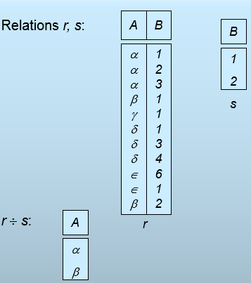
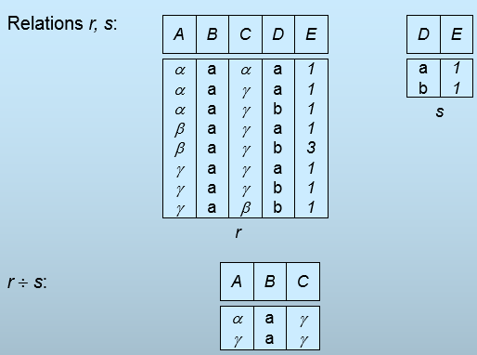
Example

Slide 62
6.5 The Rename Operation
The results of relational-algebra expressions do not have a name that we can use to refer to them. The rename operator, ρ , is provided for that purpose
The expression:
ρ_{x} (E)
Returns the result of expression E under the name x
ρ_{Phys_teacher}[σ _{dept_name=“Physics”} (instructor)]
ρ_{x/y} (R) :i.e. attribute y of relation R is now renamed as x
ρ_{B} (A) : relation A is now renamed as B

Slide 63
6.6 The Assignment Operation
It is convenient at times to write a relational-algebra expression by assigning parts of it to temporary relation variables.
The assignment operation is denoted by ← and works like assignment in a programming language.
Example: Find all instructor in the “Physics” and Music department. Physics ← σ _{dept_name=“Physics”} (instructor)
Music ← σ _{dept_name=“Music”} (instructor)
Physics ∪ Music
With the assignment operation, a query can be written as a sequential program consisting of a series of assignments followed by an expression whose value is displayed as the result of the query.

Slide 64
Equivalent Queries
There is more than one way to write a query in relational algebra.
Example: Find information about courses taught by instructors in the Physics department with salary greater than 90,000
Query 1
σ _{dept_name=“Physics”} ∧ _{salary > 90,000} (instructor)
Query 2
σ _{dept_name=“Physics”} (σ _{salary > 90.000} (instructor))
The two queries are not identical; they are, however, equivalent -- they give the same result on any database.

Slide 65
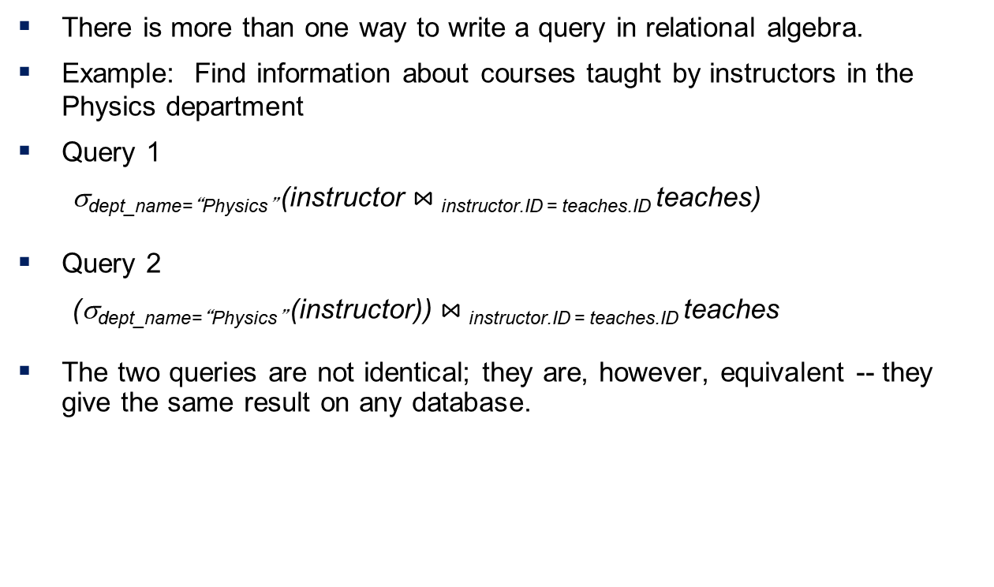
Equivalent Queries
There is more than one way to write a query in relational algebra.
Example: Find information about courses taught by instructors in the Physics department
Query 1
σ_{dept_name=“Physics”} (instructor $⋈_{ }$_{instructor.ID = teaches.ID} teaches)
Query 2
(σ_{dept_name=“Physics”} (instructor)) $⋈_{ }$_{instructor.ID = teaches.ID} teaches
The two queries are not identical; they are, however, equivalent -- they give the same result on any database.

Slide 66
Exercise
1. Consider the relations r₁(P, Q, R) and r₂(R, S, T) with primary keys P and R respectively. The relation r₁ contains 2000 tuples and r₂ contains 2500 tuples. The maximum size of the join r₁⋈ r₂ is.
(A) 2000 (B) 2500 (C) 4500 (D) 5000
2. Consider a database table T containing two columns X and Y each of type integer. After the creation of the table, one record (X=1, Y=1) is inserted in the table.
Let MX and MY denote the respective maximum values of X and Y among all records in the table at any point in time. Using MX and MY, new records are inserted in the table 128 times with X and Y values being MX+1, 2*MY+1 respectively. It may be noted that each time after the insertion, values of MX and MY change. What will be the output of the following SQL query after the steps mentioned above are carried out?
SELECT Y FROM T WHERE X=7;

Slide 67
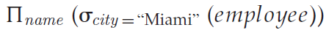
Example 1
employee (name, street, city)
works (name, cname, salary)
company (cname, city)
Find the names of all employees who live in city “Miami”.
Find the names of all employees whose salary is greater than $100,000.
Find the names of all employees who live in “Miami” and whose salary is greater than $100,000.
or

Slide 68
Example 2
branch (branch-name, branch-city, assets)
customer (customer-name, customer-street, customer-only)
account (account-number, branch-name, balance)
loan (loan-number, branch-name, amount)
depositor (customer-name, account-number)
borrower (customer-name, loan-number)
Find the names of all branches located in “Chicago”.
Find the names of all borrowers who have a loan in branch “Downtown”.

Slide 69
Example Queries
_{amount > 1200} (loan)
Find all loans of over $1200
Find the loan number for each loan of an amount greater than $1200
_{loan-number} (_{amount} _{> 1200} (loan))
Find the names of all customers who have a loan, an account, or both, from the bank
_{customer-name} (borrower)  _{customer-name} (depositor)
Find the names of all customers who have a loan and an account at bank.
_{customer-name} (borrower)  _{customer-name} (depositor)
Find the names of all customers who have a loan at the Perryridge branch.
_{customer-name} (_{branch-name=“Perryridge”}
(borrower.loan-number = loan.loan-number(borrower x loan)))

Slide 70
Example Queries
Find the names of all customers who have a loan at the Perryridge branch but do not have an account at any branch of the bank.
_{customer-name} (_{branch-name = “Perryridge”}
(borrower.loan-number = loan.loan-number(borrower x loan))) – _{customer-name}(depositor)
Find the names of all customers who have a loan at the Perryridge branch.
Query 1 _{customer-name}(_{branch-name = “Perryridge”} ( borrower.loan-number = loan.loan-number(borrower x loan)))
Query 2
_{customer-name}(loan.loan-number = borrower.loan-number( (_{branch-name = “Perryridge”}(loan)) x borrower))

Slide 71
Find the largest account balance( Rename account relation as d )
_{balance}(account) - _{account.balance}
(_{account.balance < d.balance} (account x ρ_{d} (account)))
1 | A | 500
2 | B | 300
3 | C | 700
1 | A | 500
2 | B | 300
3 | C | 700
account
d(account)
1 | A | 500 | 1 | A | 500
1 | A | 500 | 2 | B | 300
1 | A | 500 | 3 | C | 700
2 | B | 300 | 1 | A | 500
2 | B | 300 | 2 | B | 300
2 | B | 300 | 3 | C | 700
3 | C | 700 | 1 | A | 500
3 | C | 700 | 2 | B | 300
3 | C | 700 | 3 | C | 700
1 | A | 500 | 1 | A | 500
1 | A | 500 | 2 | B | 300
1 | A | 500 | 3 | C | 700
2 | B | 300 | 1 | A | 500
2 | B | 300 | 2 | B | 300
2 | B | 300 | 3 | C | 700
3 | C | 700 | 1 | A | 500
3 | C | 700 | 2 | B | 300
3 | C | 700 | 3 | C | 700
account x d

Slide 72
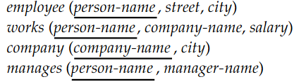


Example 3

Slide 73



Continue..

Slide 74

Example 4

Slide 75



Slide 76
Example 5
Suppliers(sid, sname, address)
Parts(pid, pname, color)
Catalog(sid, pid, cost)

Slide 77


Suppliers(sid, sname, address)
Parts(pid, pname, color)
Catalog(sid, pid, cost)

Slide 78





Suppliers(sid, sname, address)
Parts(pid, pname, color)
Catalog(sid, pid, cost)
← --
---

Slide 79
Example
Reserves(sid, bid, day)
Sailors(sid, sname, rating, age)
Boats(bid, bname, color)
Find names of sailors who have reserved boat #103
Find names of sailors who have reserved a red boat
Find the colors of boats reserved by Lubber
Find the names of sailors who have reserved at least one boat
Find the names of sailors who have reserved a red or a green boat
Find the names of sailors who have reserved a red and a green boat
Find the sids of sailors with age over 20 who have not reserved a red boat

Slide 80

Reserves(sid, bid, day)
Sailors(sid, sname, rating, age)
Boats(bid, bname, color)

Slide 81
Tuple and domain relational calculus
It is non procedural query language: described the desired information without giving a specific procedure for obtaining that information.
A query in tuple relational calculus is expressed as:
{ t | P(t) }
this represents a set of all tuples t such that predicate P is true for t
t is a tuple variable, t [A ] denotes the value of tuple t on attribute A
t ∈ r denotes that tuple t is in relation r
P is a formula similar to that of the predicate calculus
Set of comparison operators: (e.g., <, ≤, =, ≠, >, ≥)
Set of connectives: and (∧), or (v)‚ not (¬)
Implication (⇒): x ⇒ y, if x is true, then y is true
x ⇒ y ≡ ¬x v y
Set of quantifiers:
∃ t ∈ r (Q (t )) ≡ ”there exists” a tuple in t in relation r such that predicate Q (t ) is true
∀t ∈ r (Q (t )) ≡ Q is true “for all” tuples t in relation r

Slide 82
Qualifying conditions: are made up of well formed formula(wff) of predicate logic. A wff contains a set of atoms and logical connections and quantifiers which connects these atoms.
Atoms:
Tuple variable membership expression( t ∈ R)
Condition expressions:
t[a] op t[b] : t[name]=s[name]
t[a] op c : t[name]=‘amit’, t[salary]>1000
Where op= <, ≤, =, ≠, >, ≥
Not p = ¬ p
P and Q= P ^ Q
P or Q = P v Q

Slide 83
Examples
Query: find all the employee whose salary is greater than 1000;
employee( eid, name, salary)
{ t | P(t) }={ t | t∈ employee ^ t[salary] > 1000 } or
{ t | P(t) }={ t | t∈ employee ^ t.salary > 1000 }
Example: If want only name attribute from the previous example:
{ t | P(t) }={ t[name] | t∈ employee ^ t[salary] > 1000 }
Or alternatively using free and bind variable
{ t | e∃(e∈ employee ^ e[salary] > 1000)^t[name]=e[name] }
Where t is free variable and e is bounded variable according to first order logic

Slide 84
sales_person(spid, spname, mgrid, city, comm)
Give information of all the sales persons from Mumbai.
{ t | t∈ sales_person ^ t[city] =‘Mumbai’ }
Give information of sales persons with id 11.
{ t | t∈ sales_person ^ t[spid] = 11 }
Give information of all the sales persons working under managers with id not less than 20.
{ t | t∈ sales_person ^ t[mgrid] >= 20 }
Give information of all the sales persons whose commission is less than 12 or who are from Mumbai.
{ t | t∈ sales_person ^ t[comm] < 12 v t[city]=‘Mumbai’ }
Give information of all the sales person from Mumbai whose commission are less than 12.
{ t | t∈ sales_person ^ t[comm] < 12 ^ t[city]=‘Mumbai’ }

Slide 85
branch (branch-name, branch-city, assets)
customer (customer-name, customer-street, customer-only)
account (account-number, branch-name, balance)
loan (loan-number, branch-name, amount)
depositor (customer-name, account-number)
borrower (customer-name, loan-number)
List name of branches in the bank.
{ t[branch-name] | t∈ branch }
Find names of all branches where asset is more than Rs. 25000.
{ t[branch-name] | t∈ branch ^ t[assets]>25000 }
List the name of all the customers who have an account with balance greater than Rs 5000.
{ t| ∃ d∈ depositor ^ ∃ a∈ account ^d[account-number]=a[account-number] ^ a[balance]>5000^ t[customer-name]= d[customer-name] }
Find name of all the customers who have deposit in every branch located at miami.
{ t | ∃ d∈ depositor^ ∃ a∈ account ^(d[account-number]=a[account-number])^ ∀ br∈branch (br[branch-name]=a[branch-name]^br[branch-city]=‘miami)
^ t[customer-name] = d[customer-name] }

Slide 86
branch (branch-name, branch-city, assets)
customer (customer-name, customer-street, customer-only)
account (account-number, branch-name, balance)
loan (loan-number, branch-name, amount)
depositor (customer-name, account-number)
borrower (customer-name, loan-number)
Find the branch name, loan number and amount for loans of over Rs. 12000
{t | t∈ loan ∧ t[amount] >12000}
Find the names of all customers having a loan and account or both at the bank
{t | c∈ customer ^∃ b(b∈ borrower^c[customer-name] = b[customer-name]) ∨ ∃d (d∈depositor^ c[customer-name] = d[customer-name]^ t[customer-name] = c[customer-name] )
Find the names of all the customers who have a loan and an account at the bank.
{t| c∈ customer ^∃ b(b∈ borrower^c[customer-name] = b[customer-name]) ^ ∃d (d∈depositor^ c[customer-name] = d[customer-name]^ t[customer-name] = c[customer-name] )

Slide 87
branch (branch-name, branch-city, assets)
customer (customer-name, customer-street, customer-only)
account (account-number, branch-name, balance)
loan (loan-number, branch-name, amount)
depositor (customer-name, account-number)
borrower (customer-name, loan-number)
Find the names of all customers having a loan at the Perryridge branch
{t| ∃ b∈ borrower^ ∃ l ∈ loan^(b[loan-number] = l[loan-number]^( l[branch-name] = “Perryridge”)^ t[customer-name] = b[customer-name] }

Slide 88
Domain Relational Calculus
A nonprocedural query language equivalent in power to the tuple relational calculus
Each query is an expression of the form:
{ <x1, x2, ..., xn> | P(x1, x2, ..., xn) }
x1, x2, ..., xn represent domain variables
P(x) represents a formula similar to that of the predicate calculus
Employee(eid, ename, salary)
a b c
Where a, b, c are the domain variables.

Slide 89
sales_person(spid, spname, mgrid, city, comm)
Give information of all the sales persons from Mumbai.
{<spid, spname, mgrid, city, comm>|< spid, spname, mgrid, city, comm>∈ sales_person ^ city =‘Mumbai’ }
Find the names of sales persons from Mumbai.
{<spname>| <spid, spname, mgrid, city, comm>∈ sales_person ^ city =‘Mumbai’ }
Give information of all the sales persons working under managers with id not less than 20.
{<spid, spname, mgrid, city, comm>| <spid, spname, mgrid, city, comm>∈ sales_person ^ mgrid >=20 }
Give information of all the sales persons whose commission is less than 12 or who are from Mumbai.
{<spid, spname, mgrid, city, comm>| <spid, spname, mgrid, city, comm>∈ sales_person ^ city =‘Mumbai’ v comm<12 }
Give information of all the sales person from Mumbai whose commission are less than 12.
{<spid, spname, mgrid, city, comm>| <spid, spname, mgrid, city, comm>∈ sales_person ^ city =‘Mumbai’ ^ comm<12 }

Slide 90
branch (branch-name, branch-city, assets)
customer (customer-name, customer-street, customer-only)
account (account-number, branch-name, balance)
loan (loan-number, branch-name, amount)
depositor (customer-name, account-number)
borrower (customer-name, loan-number)
List names of all branches in the bank.
{<bn >| <bn, bc, a >∈ branch}
Find the loan-number, branch-name, and amount for loans of over $1200
{<ln, bn, a >| <ln, bn, a >∈ loan ∧ a>1200}
Find the names of all customers who have a loan of over $1200 {natural join, condition= ∃ln }
{ <cn>| ∃ln (<cn, ln >∈ borrower ∧<ln, bn, a >∈ loan ∧ a>1200) }
Find the names of all customers who have a loan from the miami branch
{<cn, a>| ∃ln (<cn, ln>∈borrower ∧∃b(<ln, bn, a >∈loan∧b= “miami”))}
Find the names of all customers having a loan, an account, or both at the Perryridge branch:
{<c>| ∃l ({<c, l>∈borrower ∧∃b,a(<l, b, a >∈loan∧b= “Perryridge”))∨∃a(<c, a>∈depositor∧∃b,n(<a, b, n >∈account∧b= “Perryridge”))}
Find the names of all customers who have an account at all branches located in Brooklyn:
{<c>| ∃s, n (<c, s, n>∈customer) ∧∀x,y,z(<x, y, z >∈branch∧y= “Brooklyn”) ⇒∃a,b(<x, y, z >∈account∧<c,a>∈depositor)}

Slide 91

Miscellaneous

Slide 92

Miscellaneous

Slide 93


Slide 94


Slide 95


Slide 96
An instance of a relational scheme R(A, B, C) has distinct values for attribute A. Can you conclude that A is a candidate key for R? [True\False]
Consider the join of a relation R with a relation S. If R has m tuples and S has n tuples then the maximum and minimum sizes of the join respectively are
(a) m + n and 0
(b) mn and 0
(c) m + n and |m – n|
(d) mn and m + n
The relational algebra expression equivalent to the following tuple calculus expression:
{t/t ∈ R ∧ (t[A] = 10 ∧ t[B] = 200} is:
(A) σ (A=10∨B=20) (r)
(B) σ (A=10) (r) ∪ σ (B=20) (r)
(C) σ (A=10) (r) ∩ σ (B=20) (r)
(D) σ (A=10) (r) - σ (B=20) (r)

Slide 97
With regard to the expressive power of the formal relational query languages, which of the following statements is true? (a) Relational algebra is more powerful than relational calculus. (b) Relational algebra has the same power as relational calculus. (c) Relational algebra has the same power as safe relational calculus. (d) None of the above.
Let R₁ (A,B,C) and R₂ (D,E) be two relation schema, where the primary keys are shown underlined, and let C be a foreign key in R₁ referring to R₂. Suppose there is no violation of the above referential integrity constraint in the corresponding relation instances r₁ and r₂. Which one of the following relational algebra expressions would necessarily produce an empty relation? (a) ⊓_{D}(r₂) - ⊓_{C}(r₁) (b) ⊓_{C}(r₁) - ⊓_{D}(r₂) (c) ⊓_{D}(r₁ ⋈ _{C≠D}r₂) (d) ⊓_{C}(r₁ ⋈ _{C≠D}r₂)

Slide 98


